Slide 1
God’s Unfolding Plan of Salvation

Slide 2

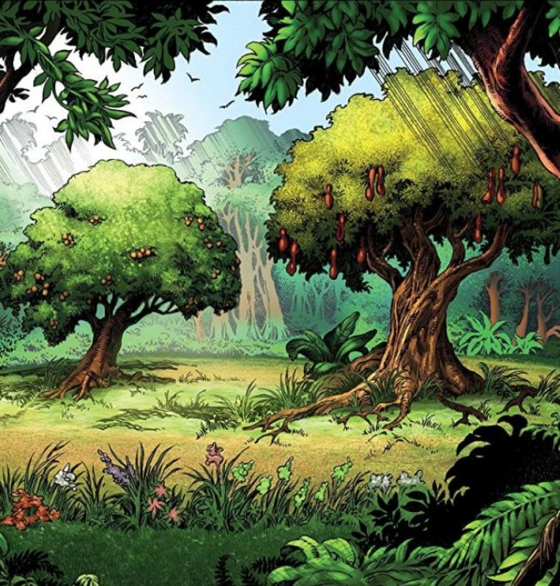
God’s Unfolding Plan of Salvation
Tree of life
in the garden of Eden
Tree of life
in Heaven
The Story of Jesus
Gen. 2:9
Rev. 22:2
Notes:
Gen. 2:9 “And out of the ground the Lord God made every tree grow that is pleasant to the sight and good for food. The tree of life was also in the midst of the garden, and the tree of the knowledge of good and evil.”
Rev. 22:1-1 “And he showed me a ^{[a]}pure river of water of life, clear as crystal, proceeding from the throne of God and of the Lamb. ² In the middle of its street, and on either side of the river, was the tree of life, which bore twelve fruits, each tree yielding its fruit every month. The leaves of the tree were for the healing of the nations.”
The story of Jesus (from creation):
“All things were made through Him, and without Him nothing was made that was made.” (John 1:3)
“For by Him all things were created that are in heaven and that are on earth, visible and invisible, whether thrones or dominions or principalities or powers. All things were created through Him and for Him.” (Col. 1:16)

Slide 3
17 Bible Periods
Tree of life
in the garden of Eden
Tree of life
in Heaven
Gen. 2:9
Rev. 22:2

Slide 4
Before the flood
Divided Kingdom
The flood
Judah Alone
Scattering of people
Captivity
Patriarchs
Return from captivity
Exodus
Wanderings in wilderness
Years of silence
Life of Christ
Invasion & conquest of land
Early church
Judges
Letters to Christians
United Kingdom

Slide 5
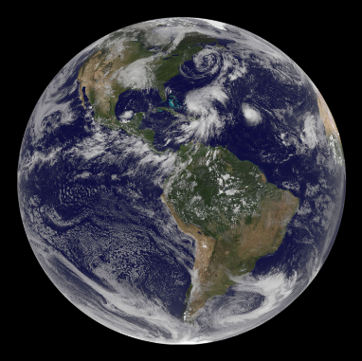
Why Geography?

Slide 6
Why Geography?
Gen. 1:1
“In the beginning, God created the heavens and the earth”
Job 26:7
“He stretches out the north over empty space; He hangs the earth on nothing.”

Slide 7
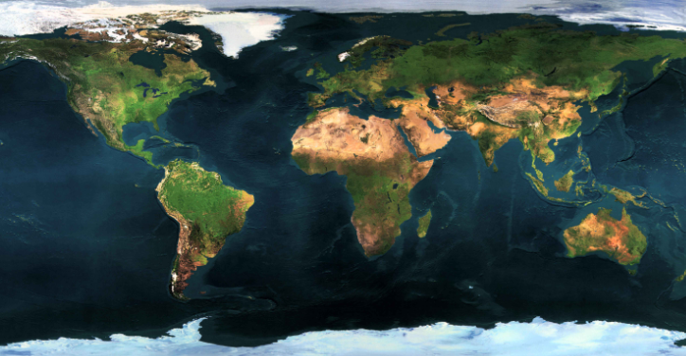
Athens, Alabama
Approximate area for the bible story

Slide 8
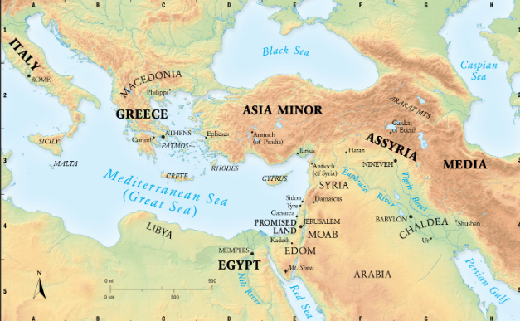

Slide 9
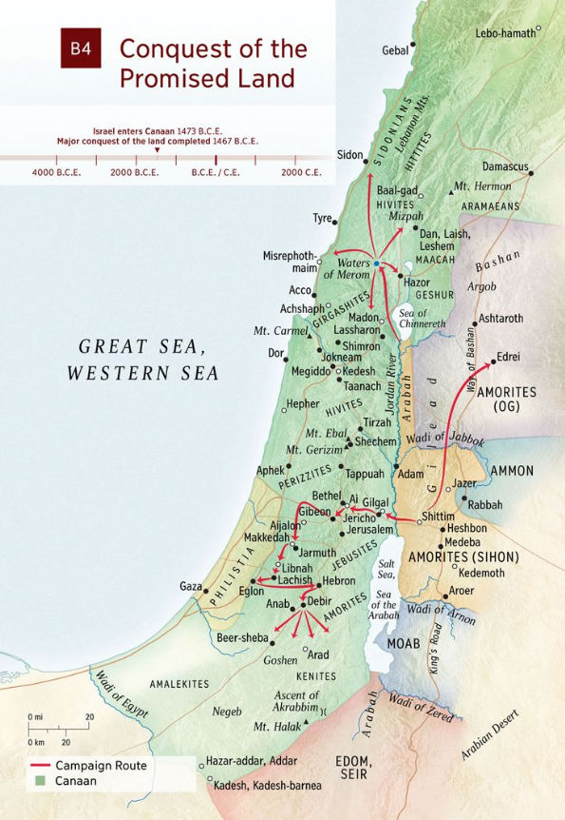

Slide 10
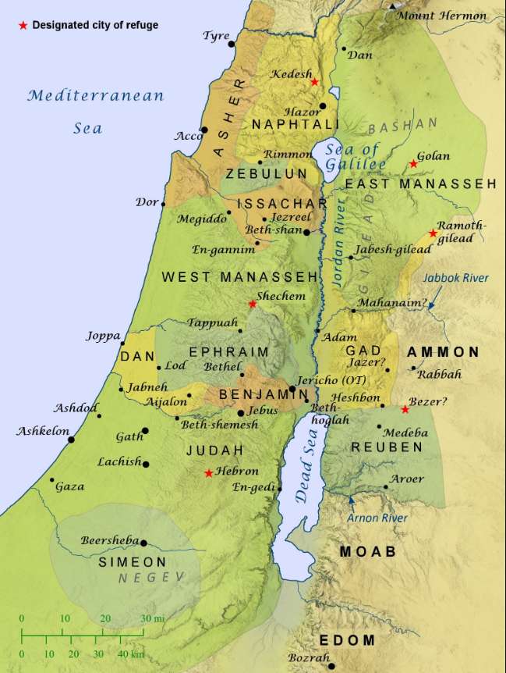
Promised
Land
Divided;
Num. 32
Joshua 13-15

Slide 11
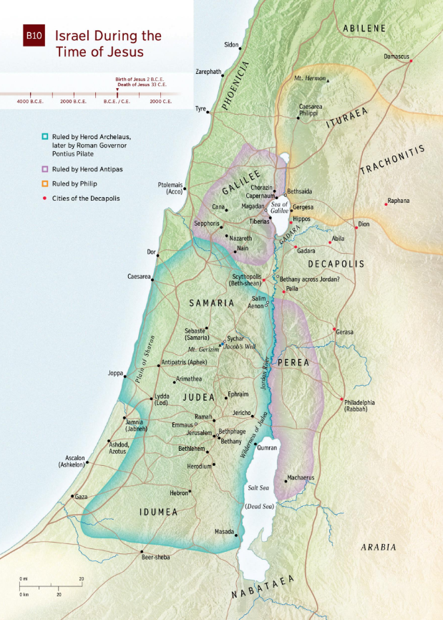

Slide 12
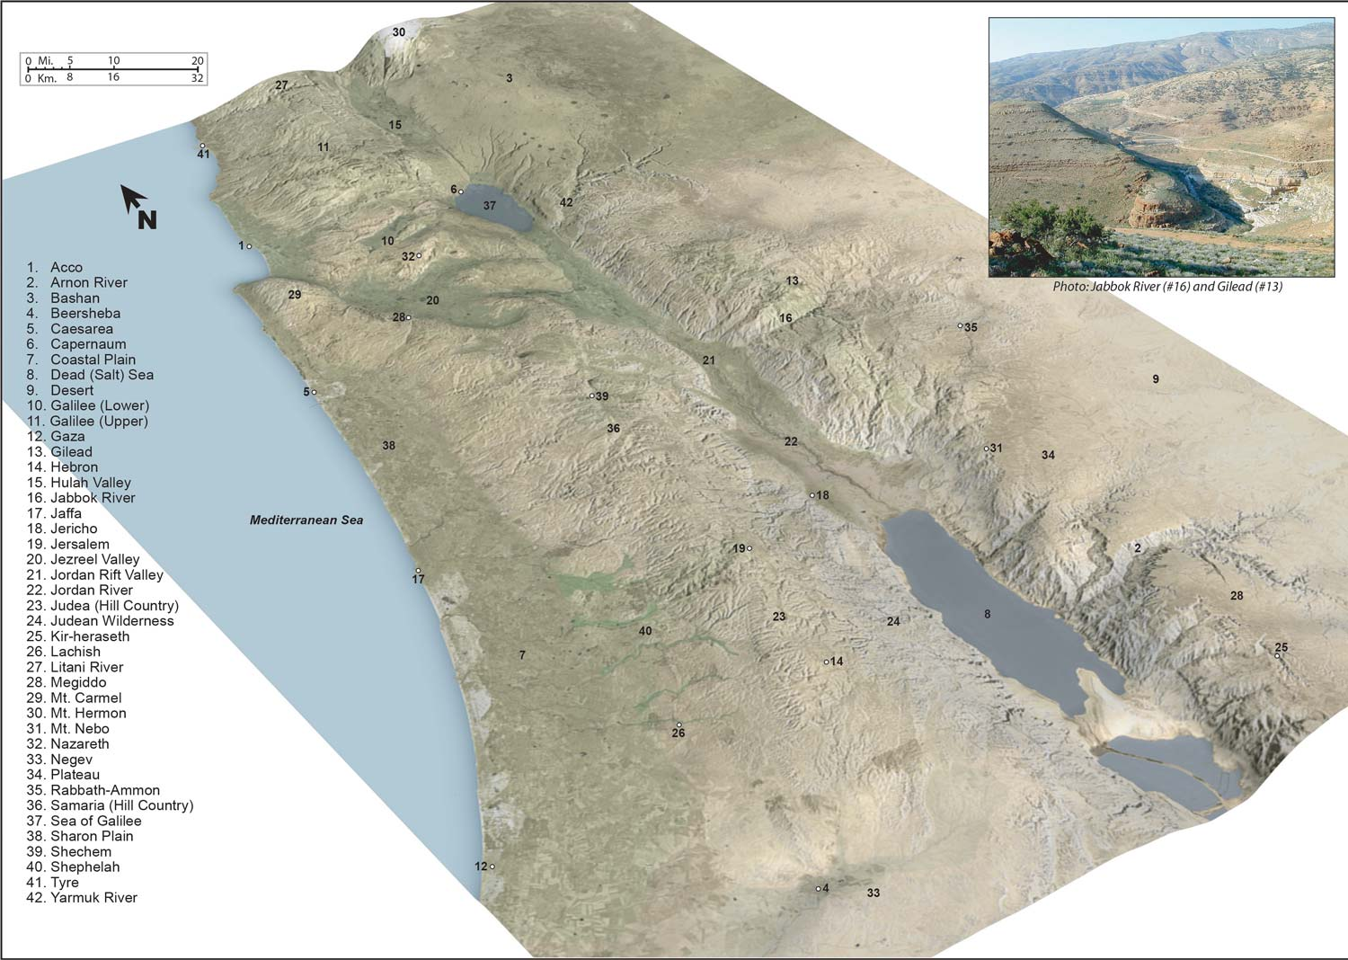

Slide 14
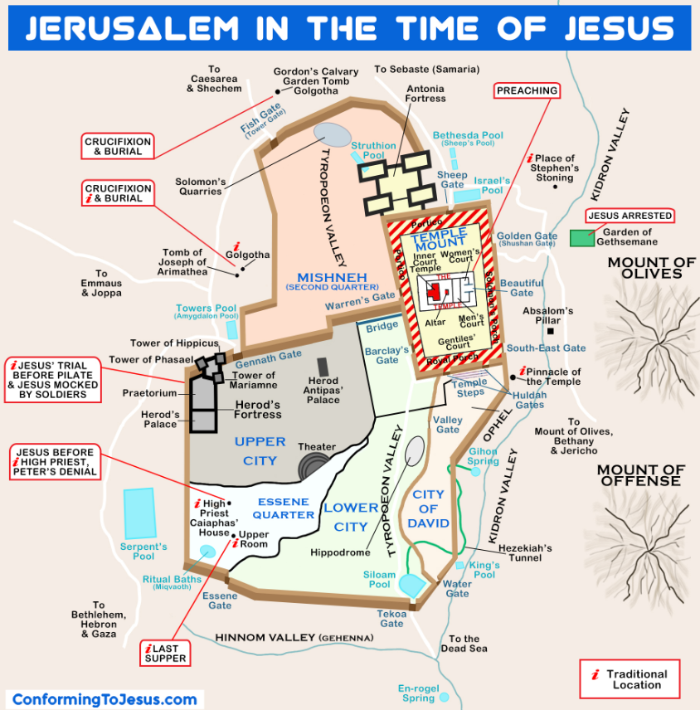

Slide 15
Why Geography?
The individuals and the places that we read about and discuss in the bible are real.
Let’s get to know them better!

Slide 16
Why study the OT?
It teaches us what sin is (Romans 7:7)
It is our tutor (schoolmaster) to bring us to Christ. (Gal. 3:25-25)
Through it we learn …
God’s character
How our actions make God feel.
God’s power
God’s holiness

Slide 17
Why study the OT?
It was written for our learning (Romans 15:4)
It is profitable for us (2 Tim. 3:16-17)
It is vital to our understanding of the New Testament (Hebrews 10, John 5)

Slide 18
Covenant
“I pray, Lord God of heaven, O great and awesome God, You who keep Your covenant and mercy with those who love You and observe Your commandments,…”
Nehemiah 1:5
Notes:
Covenant: a usually formal, solemn, and binding agreement
New: ref. Heb. 7:22; 8:6-13

Slide 19
Covenant
Old
New
High Priest
Jesus Christ our High Priest
(Heb. 4:14-15)
Once a year, he would Sacrifice a bull to make atonement for himself, and a goat to make atonement for the people
(Lev. 16)
Sacrificed Himself to make atonement for all
Notes:
Covenant: a usually formal, solemn, and binding agreement
New: ref. Heb. 7:22; 8:6-13

Slide 20
Covenant
Old
New
Priests
You & I
(1 Pt. 2:9)
Offer sacrifices to God (Lev.18:2-7)
Learn and teach God’s word
Connect people to God
We should offer ourselves
(Rom. 12:1-2)
We should be teachers
(Heb. 5:12-14)
Notes:
Covenant: a usually formal, solemn, and binding agreement
New: ref. Heb. 7:22; 8:6-13

Slide 21
Covenant
Old
New
Priests
You & I
(1 Pt. 2:9)
Offer sacrifices to God (Lev.18:2-7)
Learn and teach God’s word
Connect people to God
We should offer ourselves (Rom. 12:1-2)
We should be teachers
(Heb. 5:12-14)
We should connect people to Christ
(Heb. 10:19-25)
Notes:
Covenant: a usually formal, solemn, and binding agreement
New: ref. Heb. 7:22; 8:6-13

Slide 22
God’s Unfolding Plan of Salvation
Learn it
Love it
Live it

